Slide 1


Umamaheswaran & Vishnu Balachandran
Senior Software Engineer – BizTalk360
Introduction to Azure API Apps

Slide 2
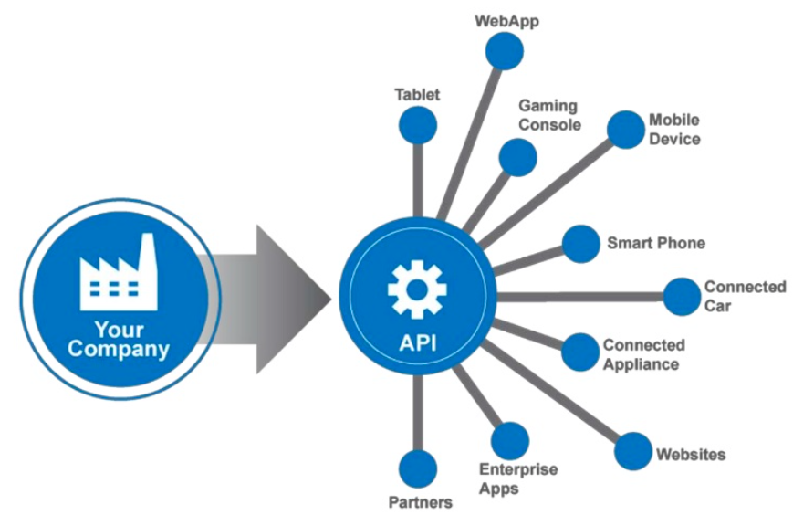
What is API?
Application Programming Interface
Exposing Services and Logic
Web API leverages HTTP Protocol
Availability and Security can be challenging
How Azure App Service can solve this
Notes:
Application Programming Interface
Exposing services and logic in ways which could be easily leveraged by other services and developers
A web API makes it easy to build services and logic over HTTP protocol
It’s a great effort to create availability and security by managing the services themselves in a reasonable and standardized way.
Azure App Service can handle this for us

Slide 3
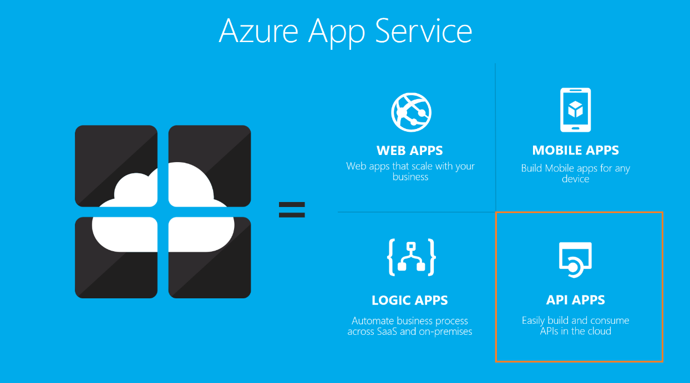
Azure API Apps
API apps makes it easy to develop, host and consume APIs in the cloud and on premises
Leverages enterprise grade security, simple access control, hybrid connectivity,
Automatic SDK generation
Seamless integration with Logic Apps
Notes:
API Apps are a part of Azure App Service Offering

Slide 4




API App Concepts
Authentication via:
Enterprise-grade security
Simple access control
Automatic SDK generation
Standardized service integration
Versioning
Scaling
Notes:
High Availability
Geo Replication

Slide 5
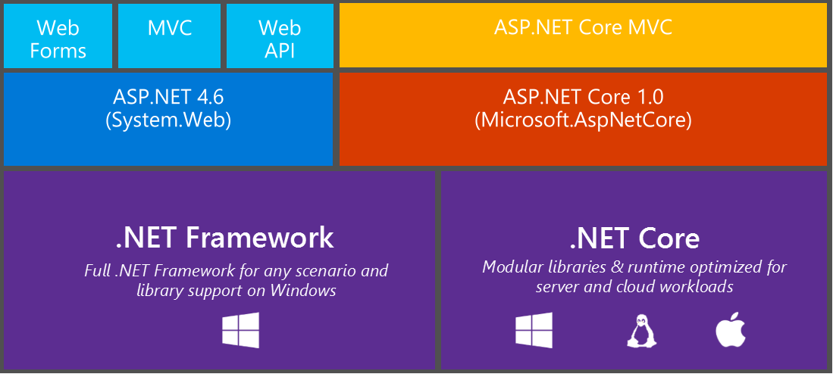
Developing APIs
Developing Azure APIs and API Apps with Visual Studio is similar to developing Web API solutions with Visual Studio, except that the Azure App Service control integration, authentication, and other cumbersome tasks
Notes:
Create a ASP.NET Web API Project
Choose Azure API App Sub Template
Explain why Authentication is disabled
NEXT DEMO

Slide 6
Common Web API Concepts
Configuration
Routes & Route Mapping
Controllers
Verbs
Http Response Messages
Http async Action Results

Slide 7

Discovery
Swagger is the new standard
Swashbuckle adds swagger support
Swagger dynamically creates
Testing UI
API Definition
Help Documentation
Discovery enables packaging and integrated reuse for any device and on any client

Slide 8
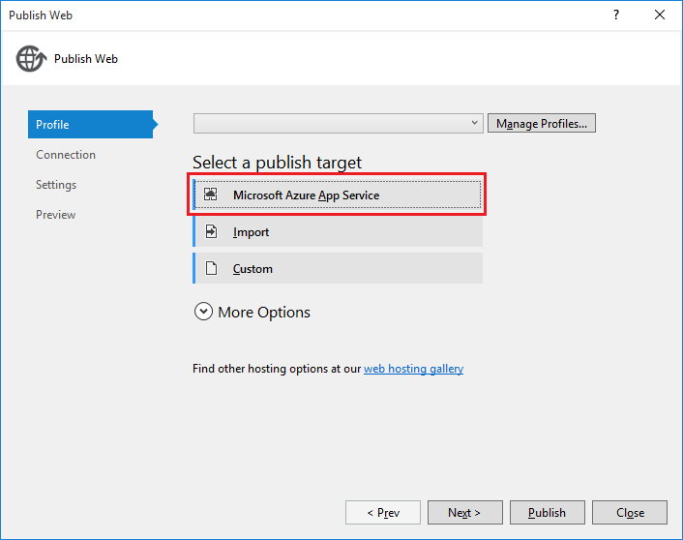
Deployment
Typically happens via Visual Studio
Application Settings frameworks
Deployment Options
Steps
Publish
Commit (Git, VSTS etc)
Auto Deploy

Slide 9
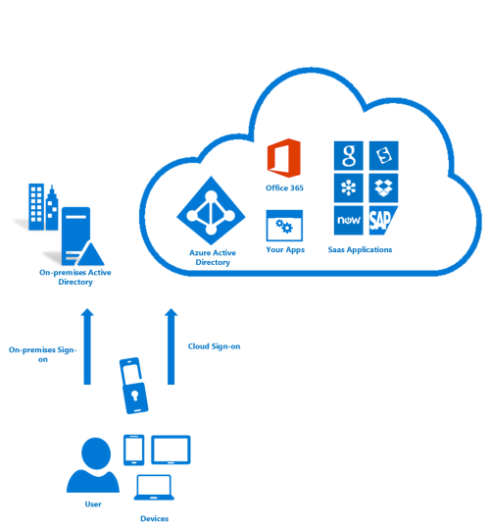
Authentication
Authentication is managed in the App Service Level, but initiated in your controllers
Authentication can be performed against
Azure AD
Microsoft Accounts
3rd Party Services such as Facebook, Twitter
Custom Scenarios

Slide 10
Consuming APIs
Visual Studio projects via REST Service tool
Windows Store Apps
Windows Desktop Apps
Universal Windows Apps
Xamarin Forms Apps
Console Apps
Web and Web API Apps
Azure Logic Apps
Microsoft Power Apps

Slide 11
Thank you

